Slide 1
What’s the genre of news?
April 22

Slide 2
ML Development Methodology
Business Understanding
Data Requirements
Data
Collecting
+
understanding
Data
preparation
ML Model
Development
Evaluation
Predict the genre of news
News Headline: ONTARIO FESTIVALS RETURNING IN 2022
1

Slide 3
ML Development Methodology
Business Understanding
Data Requirements
Data
Collecting
+
understanding
Data
preparation
ML Model
Development
Evaluation
News Headline: ONTARIO FESTIVALS RETURNING IN 2022
Author: TodoOntario
Short Description: Many Ontario festivals are back this year. It’s time to dust off your festival shoes and get back out there.
2

Slide 4
ML Development Methodology
Business Understanding
Data Requirements
Data
Collecting
+
understanding
Data
preparation
ML Model
Development
Evaluation
 | category | headline | authors | link | short_description | date
0 | CRIME | There Were 2 Mass Shootings In Texas Last Week... | Melissa Jeltsen | https://www.huffingtonpost.com/entry/texas-ama... | She left her husband. He killed their children... | 2018-05-26
1 | ENTERTAINMENT | Will Smith Joins Diplo And Nicky Jam For The 2... | Andy McDonald | https://www.huffingtonpost.com/entry/will-smit... | Of course it has a song. | 2018-05-26
... | ... | ... | ... | ... | ... | ...
200852 | SPORTS | Dwight Howard Rips Teammates After Magic Loss ... |  | https://www.huffingtonpost.com/entry/dwight-ho... | The five-time all-star center tore into his te... | 2012-01-28
200,853 entries
38 Unique Categories
Dataset created and owned by SRIHA Mohamed
https://www.kaggle.com/datasets/210a4af33e313cd6d800470a9926d0eb6457464c22cc5935191a9d8f1b3d025b
3

Slide 5
ML Development Methodology
Business Understanding
Data Requirements
Data
Collecting
+
understanding
Data
preparation
ML Model
Development
Evaluation
Data Preparation
  Fixing Duplicates
  Fixing Missing Values
  Text Cleaning and Tokenizing
  Label Encoding for Category column
ML Model
  Splitting data by 90% for training and 10% for test
  Vectorizing Data by TF-IDF Method
  Developing Multinomial Naive Bayes Model
Dataset created and owned by SRIHA Mohamed
https://www.kaggle.com/datasets/210a4af33e313cd6d800470a9926d0eb6457464c22cc5935191a9d8f1b3d025b
4

Slide 6
Evaluation
 | precision | recall | f1-score
art | 1.000000 | 0.006536 | 0.012987
art cultur | 0.166667 | 0.003922 | 0.007663
beauti style | 0.717391 | 0.786566 | 0.750388
black voic | 1.000000 | 0.051454 | 0.097872
busi | 0.777778 | 0.047863 | 0.090177
colleg | 0.000000 | 0.000000 | 0.000000
comedi | 0.939394 | 0.056881 | 0.107266
crime | 0.846154 | 0.060274 | 0.112532
divorc | 1.000000 | 0.094118 | 0.172043
drink food | 0.750923 | 0.669408 | 0.707826
educ | 0.000000 | 0.000000 | 0.000000
entertain | 0.517094 | 0.840278 | 0.640212
environ | 0.000000 | 0.000000 | 0.000000
fifti | 1.000000 | 0.007042 | 0.013986
good news | 0.000000 | 0.000000 | 0.000000
green | 0.000000 | 0.000000 | 0.000000
healthi live | 0.953488 | 0.060029 | 0.112948
home live | 0.994737 | 0.441589 | 0.611650
impact | 1.000000 | 0.025424 | 0.049587
 | precision | recall | f1-score
latino voic | 0.000000 | 0.000000 | 0.000000
media | 1.000000 | 0.014870 | 0.029304
money | 0.000000 | 0.000000 | 0.000000
news weird | 1.000000 | 0.007299 | 0.014493
news world | 0.000000 | 0.000000 | 0.000000
parent | 0.629851 | 0.686179 | 0.656809
polit | 0.372688 | 0.991897 | 0.541803
queer voic | 0.965174 | 0.319605 | 0.480198
religion | 1.000000 | 0.104603 | 0.189394
scienc | 1.000000 | 0.040541 | 0.077922
sport | 0.983607 | 0.248963 | 0.397351
style | 0.000000 | 0.000000 | 0.000000
tast | 0.000000 | 0.000000 | 0.000000
tech | 1.000000 | 0.019802 | 0.038835
travel | 0.806067 | 0.751515 | 0.777836
wed | 0.987342 | 0.214286 | 0.352144
well | 0.424250 | 0.931293 | 0.582942
women | 1.000000 | 0.008721 | 0.017291
worldpost | 0.862595 | 0.182553 | 0.301333
Multinomial Naive Bayes
F1-Score | 0.493987
Dataset created and owned by SRIHA Mohamed
https://www.kaggle.com/datasets/210a4af33e313cd6d800470a9926d0eb6457464c22cc5935191a9d8f1b3d025b
5

Slide 7
Evaluation
 | precision | recall | f1-score
art | 0.453237 | 0.411765 | 0.431507
art cultur | 0.480851 | 0.443137 | 0.461224
beauti style | 0.710921 | 0.719393 | 0.715132
black voic | 0.425791 | 0.391499 | 0.407925
busi | 0.370748 | 0.372650 | 0.371697
colleg | 0.373737 | 0.310924 | 0.339450
comedi | 0.582988 | 0.515596 | 0.547225
crime | 0.389262 | 0.317808 | 0.349925
divorc | 0.639296 | 0.641176 | 0.640235
drink food | 0.622356 | 0.677632 | 0.648819
educ | 0.400000 | 0.266667 | 0.320000
entertain | 0.629042 | 0.650884 | 0.639777
environ | 0.211009 | 0.172932 | 0.190083
fifti | 0.359223 | 0.260563 | 0.302041
good news | 0.392000 | 0.316129 | 0.350000
green | 0.179211 | 0.206612 | 0.191939
healthi live | 0.390602 | 0.389458 | 0.390029
home live | 0.669014 | 0.665888 | 0.667447
impact | 0.235294 | 0.203390 | 0.218182
 | precision | recall | f1-score
latino voic | 0.616822 | 0.507692 | 0.556962
media | 0.480519 | 0.412639 | 0.444000
money | 0.304965 | 0.245714 | 0.272152
news weird | 0.345048 | 0.394161 | 0.367973
news world | 0.224359 | 0.156951 | 0.184697
parent | 0.570136 | 0.614634 | 0.591549
polit | 0.687275 | 0.743998 | 0.714512
queer voic | 0.704274 | 0.678748 | 0.691275
religion | 0.489177 | 0.472803 | 0.480851
scienc | 0.386598 | 0.337838 | 0.360577
sport | 0.547210 | 0.529046 | 0.537975
style | 0.600000 | 0.572093 | 0.585714
tast | 0.561151 | 0.369668 | 0.445714
tech | 0.376404 | 0.331683 | 0.352632
travel | 0.640852 | 0.668687 | 0.654474
wed | 0.673740 | 0.697802 | 0.685560
well | 0.545455 | 0.599307 | 0.571114
women | 0.331378 | 0.328488 | 0.329927
worldpost | 0.423818 | 0.390953 | 0.406723
Decision Tree
F1-Score | 0.557457
Dataset created and owned by SRIHA Mohamed
https://www.kaggle.com/datasets/210a4af33e313cd6d800470a9926d0eb6457464c22cc5935191a9d8f1b3d025b
6

Slide 8
Evaluation
 | precision | recall | f1-score
art | 0.735632 | 0.418301 | 0.533333
art cultur | 0.703518 | 0.549020 | 0.616740
beauti style | 0.851064 | 0.866739 | 0.858830
black voic | 0.696275 | 0.543624 | 0.610553
busi | 0.615248 | 0.593162 | 0.604003
colleg | 0.585366 | 0.403361 | 0.477612
comedi | 0.733333 | 0.605505 | 0.663317
crime | 0.695906 | 0.652055 | 0.673267
divorc | 0.883562 | 0.758824 | 0.816456
drink food | 0.771341 | 0.832237 | 0.800633
educ | 0.679012 | 0.458333 | 0.547264
entertain | 0.723161 | 0.837753 | 0.776250
environ | 0.653061 | 0.240602 | 0.351648
fifti | 0.826923 | 0.302817 | 0.443299
good news | 0.750000 | 0.445161 | 0.558704
green | 0.466960 | 0.438017 | 0.452026
healthi live | 0.683857 | 0.446559 | 0.540301
home live | 0.885167 | 0.864486 | 0.874704
impact | 0.621399 | 0.426554 | 0.505863
 | precision | recall | f1-score
latino voic | 0.878049 | 0.553846 | 0.679245
media | 0.766304 | 0.524164 | 0.622517
money | 0.700000 | 0.440000 | 0.540351
news weird | 0.587786 | 0.562044 | 0.574627
news world | 0.607143 | 0.304933 | 0.405970
parent | 0.741417 | 0.825203 | 0.781070
polit | 0.760947 | 0.897059 | 0.823416
queer voic | 0.857401 | 0.782537 | 0.818260
religion | 0.720183 | 0.656904 | 0.687090
scienc | 0.757062 | 0.603604 | 0.671679
sport | 0.817352 | 0.742739 | 0.778261
style | 0.806630 | 0.679070 | 0.737374
tast | 0.751938 | 0.459716 | 0.570588
tech | 0.729032 | 0.559406 | 0.633053
travel | 0.817518 | 0.905051 | 0.859060
wed | 0.853868 | 0.818681 | 0.835905
well | 0.636553 | 0.882794 | 0.739719
women | 0.617188 | 0.459302 | 0.526667
worldpost | 0.655118 | 0.672052 | 0.663477
Logistic-Regression
F1-Score | 0.734744
Dataset created and owned by SRIHA Mohamed
https://www.kaggle.com/datasets/210a4af33e313cd6d800470a9926d0eb6457464c22cc5935191a9d8f1b3d025b
7

Slide 9
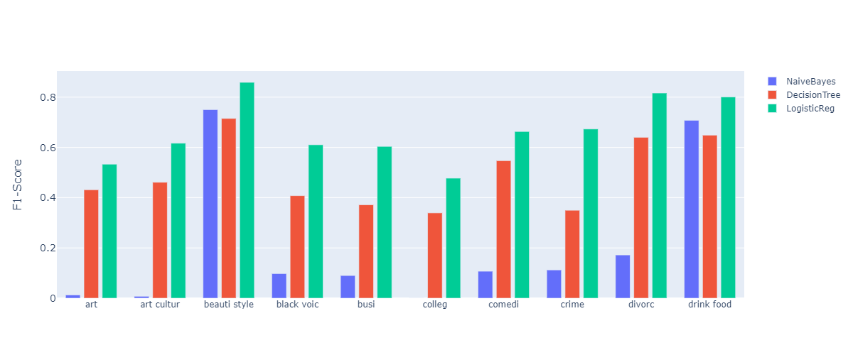
ML Development Methodology
Business Understanding
Data Requirements
Data
Collecting
+
understanding
Data
preparation
ML Model
Development
Evaluation
8

Slide 10
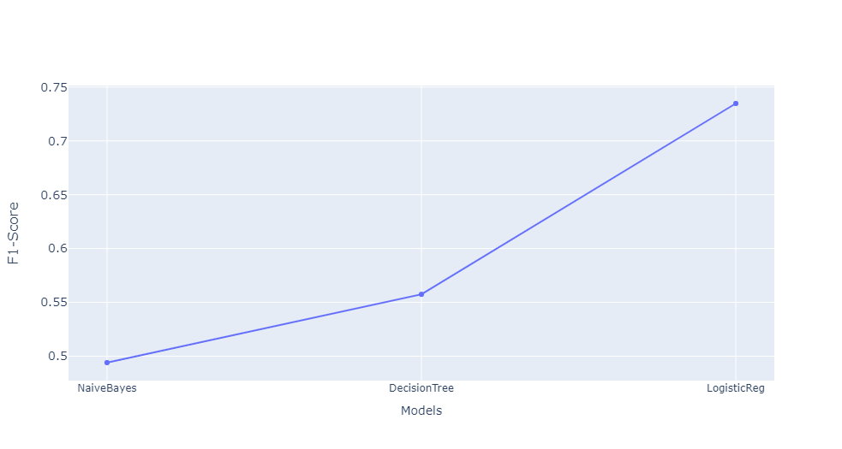
ML Development Methodology
Business Understanding
Data Requirements
Data
Collecting
+
understanding
Data
preparation
ML Model
Development
Evaluation
9

Slide 11
Next Step
Apply more practices of Data Cleaning.
Optimizing Vectorization methods by Neural Networks based methods like Word2Vec or BERT.
Training Neural Networks to classify Date, Authors and Short-Descriptions.
Dataset created and owned by SRIHA Mohamed
https://www.kaggle.com/datasets/210a4af33e313cd6d800470a9926d0eb6457464c22cc5935191a9d8f1b3d025b
10

Slide 12
Q&A
Details about Data Preparation

Slide 13

Data Preparation
Removing Duplicates
Removing Missing Values. Removing records which there are not data in both Author and Short Description columns.
Removing Emojis
Merging Author and Short Description
Fixing Contractions. (e.g. he’s -> He is)
Remove numbers and Characters
Tokenizing
Removing Stopwords. (the, a, …)
Extracting roots of words by PorterStemmer.
Extracting base form of words by Lemmatization. (Studies -> Study)
Dataset created and owned by SRIHA Mohamed
https://www.kaggle.com/datasets/210a4af33e313cd6d800470a9926d0eb6457464c22cc5935191a9d8f1b3d025b
11

Slide 14
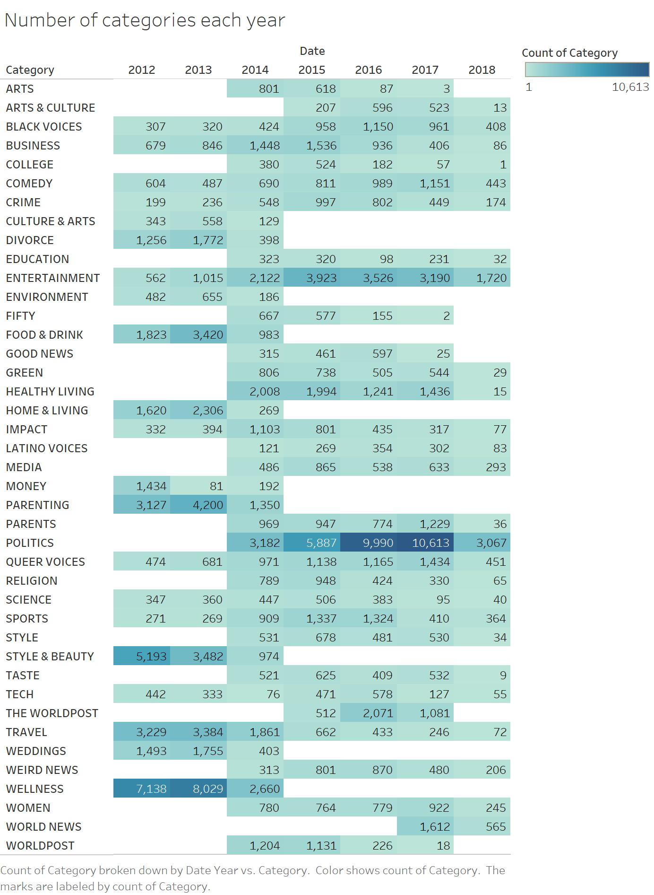
Date
12

Slide 15
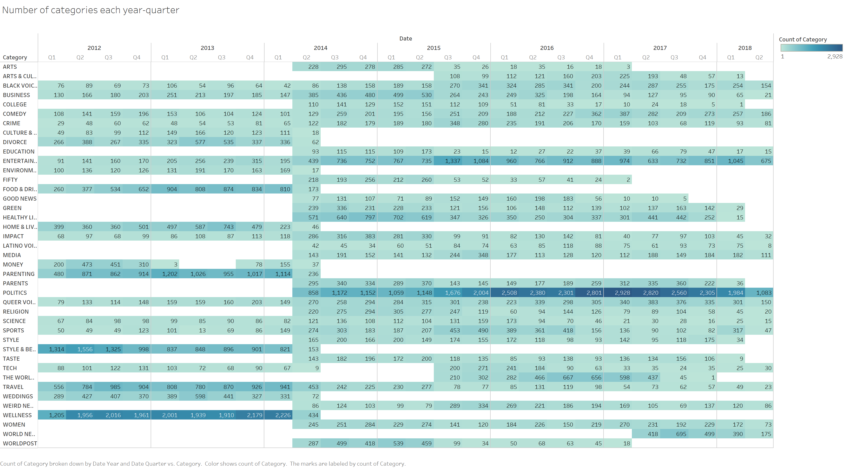
Date
13

